Slide 1
CLASSIFICATION – NAIVE BAYES
Nghia Tran 21th June

Slide 2
Agenda
Bayes theorem
Naive Bayes classifier (NBF)
Commom distribution functions in NBF
Gaussian naive Bayes
Multinomial naive Bayes
Bernoulli naive Bayes
Demo with Python

Slide 3

Bayes theorem
Wrench
Example from @SuperDataScience

Slide 4
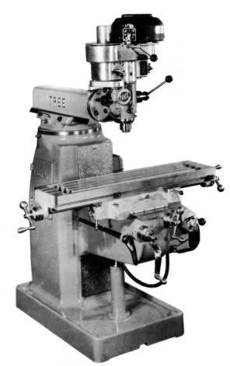
Bayes theorem
m1
m2
Example from @SuperDataScience

Slide 5

Bayes theorem
Example from @SuperDataScience

Slide 6
Bayes theorem
What’s the probability ?
m2
Example from @SuperDataScience

Slide 7
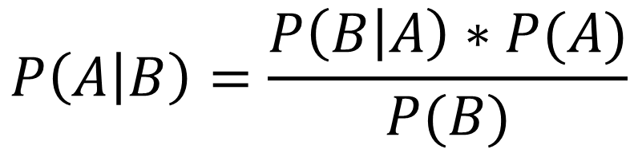
Bayes theorem
$$P\left(A | B\right)=\frac{P\left(B | A\right)∗P(A)}{P(B)}$$
Example from @SuperDataScience

Slide 8
Bayes theorem
Mach1: 30 wrenches / hours
Mach2: 20 wrenches / hours
Out of all produced parts, we can see that 1% are defective:
50% came from mach1
50% came from mach2
Question:
What is the probability that a part produced by mach2 is defective ?
→P(Mach1) = 30/50 = 0.6
P(Mach2) = 20/50 = 0.4
P(Defect) = 1%
P(Mach1 | Defect) = 50%
P(Mach2 | Defect) = 50%
→P(Defect | Mach2) = ?
Example from @SuperDataScience

Slide 9



Bayes theorem
Mach1: 30 wrenches / hours
Mach2: 20 wrenches / hours
Out of all produced parts, we can see that 1% are defective:
50% came from mach1
50% came from mach2
Question:
What is the probability that a part produced by mach2 is defective ?
→P(Mach1) = 30/50 = 0.6
P(Mach2) = 20/50 = 0.4
P(Defect) = 1%
P(Mach1 | Defect) = 50%
P(Mach2 | Defect) = 50%
→P(Defect | Mach2) = ?
$$P\left(Defect | Mach2\right)=\frac{P\left(Mach2 \right| Defect)∗P(Defect)}{P(Mach2)}$$
$$=\frac{ 0.5 ∗ 0.01 }{0.4}$$
$$=0.0125=1.25\%$$
Example from @SuperDataScience

Slide 10
Naive Bayes classifier

Slide 11
Evaluation Methods
https://machinelearningcoban.com/2017/08/31/evaluation/

Slide 12
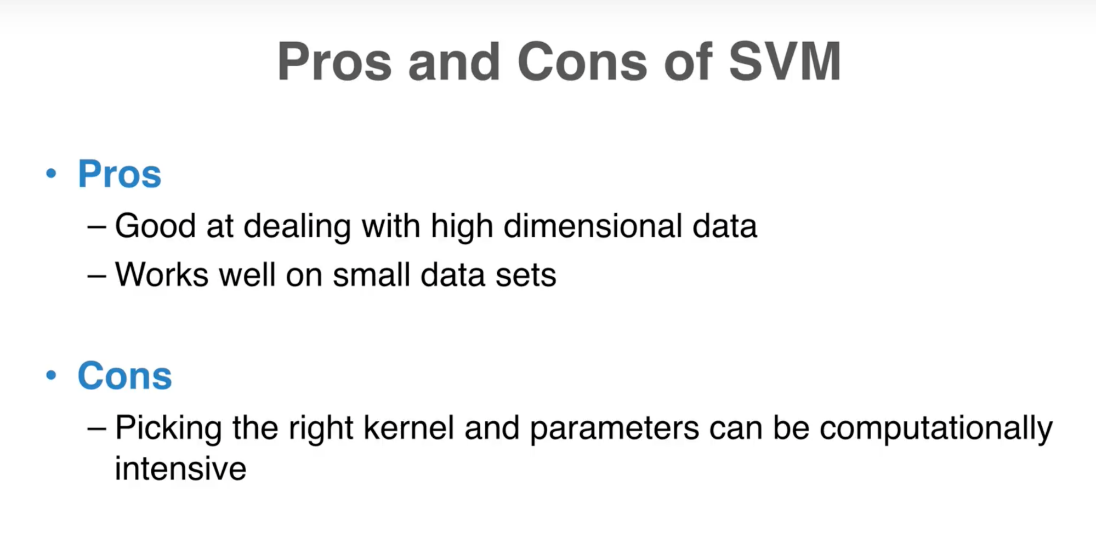
Summary

Slide 13
Demo with Python

Slide 14
References
Support Vector Machines: A Visual Explanation with Sample Python Code https://www.youtube.com/watch?v=N1vOgolbjSc
Support Vector Machine https://machinelearningcoban.com
Machine Learning A-Z
https://www.superdatascience.com/machine-learning

